Slide 1
Fixed point Multiplication
Computer System Architecture
By
M. Morris Mano

Slide 2
Ordinary Multiplication
Multiplication involves the generation of partial products – one for each digit in the multiplier.
Partial products are very simple to define for binary multiplication.
  If multiplier bit= 1, partial product = multiplicand, otherwise partial product = zero.
Total product = sum of the partial products.
Each successive partial product is shifted one position to the left.
Multiplication of two n-bit binary numbers results in a product of up to 2n bits in length.

Slide 3
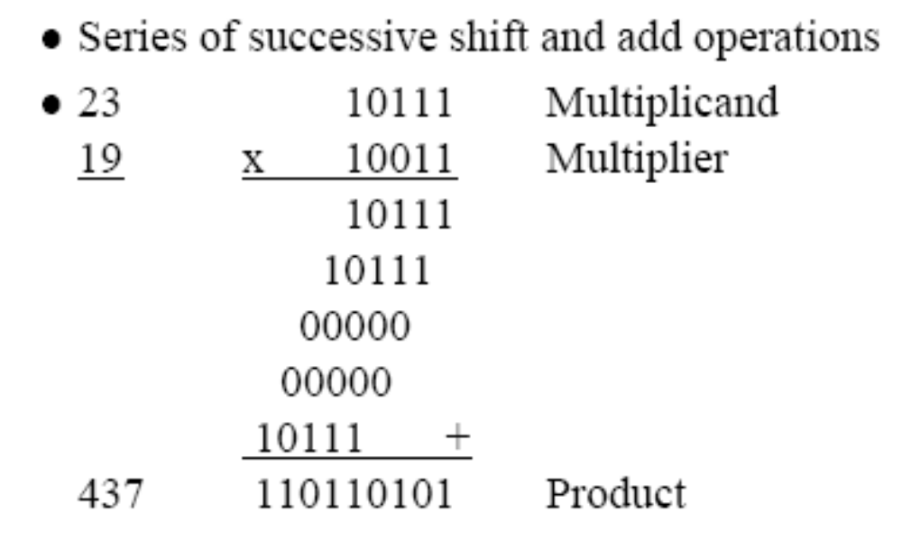
1 0 0 0 _{two} = 8₍₁₀₎ multiplicand
1 0 0 1 _{two} = 9₍₁₀₎ multiplier
____________
1 0 0 0
0 0 0 0 partial products
0 0 0 0
1 0 0 0
____________
1 0 0 1 0 0 0_{two} = 72₍₁₀₎
1011
X 1101
1011
0000
1011
1011
10001111

Slide 4
Hardware implementation for signed magnitude data
Simplified Multiplication in a digital computer:
Instead of using registers to store and add simultaneously as many binary nos. in the multiplier, it is convenient to use an adder for summation of only 2 binary nos. and successively accumulate the partial products in a register.
Instead of shifting the Multiplicand to the left , the partial product is shifted to right for placing the partial product and multiplicand at their respective positions.
When the multiplier bit=0, there is no need to add all 0’s to partial product since it will not alter the value.

Slide 5
Hardware implementation for signed magnitude data
Multiplicand – stored in register B, and its sign in B_{s}.
Product length is double. It will be stored in register A and Q.
Sum of A and B forms a partial product and transferred to EA.
Both partial product (EA) and Multiplier are shifted to the right.
  It is denoted by Shr EAQ.
  So LSB of A is shifted to into MSB of Q, the bit from E is shifted into MSB of A and 0 is shifted into E.
Finally the right most bit of Q is designated as Q_{n}, will hold the bit of Multiplier which must be inspected next.

Slide 6
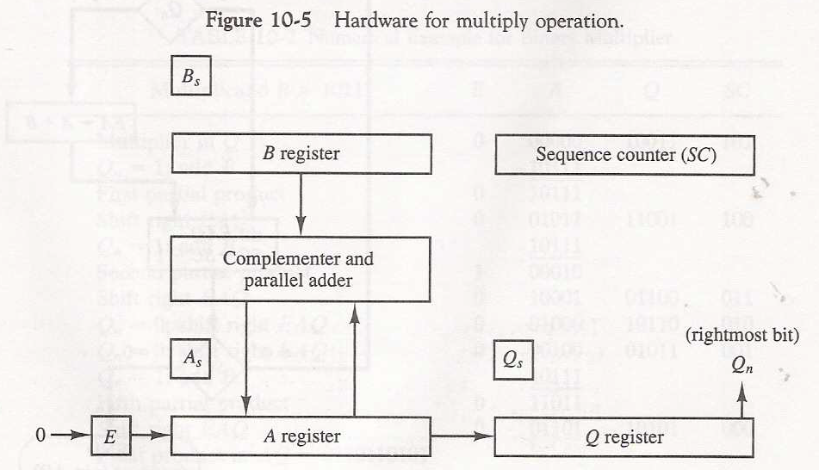
Hardware Implementation for Signed-Magnitude Multiplication

Slide 7
Hardware Implementation for Signed-Magnitude Multiplication
Initially
  Store multiplicand in B and multiplier in Q and their corresponding signs are in B_{s} and Q_{s}.
  A and E are cleared
  SC = no of bits in N.
Signs are compared and both A_{s} and Q_{s} are set to correspond to the sign of the product.
Lower bit of multiplier is tested
  If Q_{n}=1
    B is added to the present partial product in A.
  If Q_{n}=0
    Nothing is done
Then EAQ is shifted one bit right to form new partial product. (shift 1 bit at a time)
SC=SC-1
When SC=0 - Process stops or repeat the process.
Final product is available in A and Q.
A holding the MSB and Q holding LSB.

Slide 8
Description
Q - multiplier
B - multiplicand
A = 0
SC = number of bits in multiplier
E - overflow bit for A
Do SC times
  If low-order bit of Q is 1
    A ← A + B
  Shift right EAQ
Product is in AQ
For each ‘1’ in the multiplier we can apply an add and a shift.
For each ‘0’ only a shift is needed.

Slide 9
Flow chart for Multiplication (Signed Magnitude Representation)
Multiply Operation
23 × 19 = 437
Q = 19 (10011), B = 23 (10111)
Multiplicand in B
Multiplier in Q
E
A
Q
SC
A_{S} ← Q_{S} + B_{S}
Q_{S} ← Q_{S} + B_{S}
A ← 0, E ← 0
SC ← n – 1
0
00000
10011
101
Add
10111
10111
Shift
0
01011
11001
100
Add
10111
= 0
Q_{n}
= 1
1
00010
Shift
0
10001
01100
011
EA ← A + B
Shift
0
01000
10110
010
Shr EAQ
SC ← SC – 1
Shift
0
00100
01011
001
Add
10111
≠ 0
= 0
11011
SC
Shift
0
01101
10101
000
END
(Product is in AQ)

Slide 10
010111(multiplicand) and 110110(multiplier)
Q = 110110, B = 010111
E
A
Q
SC
0
00000
110110
101
Shift right
0
010111
010111
Shift right
001011
11100
100
Add
010111
0
100010
Shift right
0
010001
01110
011
Shift
0
01000
10110
010
Shift
0
00100
01011
001
Add
10111
11011
Shift
0
01101
10101
000

Slide 11
Exercise
Show the contents of registers E, A, Q and SC during the process of multiplication of two binary numbers, 11111 (multiplicand) and 10101 (multiplier). The signs are not included.

Slide 12
Observation
M X (00011110) = M X (2⁴ + 2³ +2² + 2¹)
= M X (16 + 8 + 4 + 2)
= M X 30
The number of operations can be reduced to two if we observe that:
2^{n} + 2^{n-1} + …. + 2^{n-k} = 2^{n+1} – 2^{n-k}
M X (00011110) = M X (2⁵ - 2¹)
= M X (32 - 2)
= M X 30
14 = 01110 = 2⁴ – 2¹
= 16 – 2
25 = 011001 = -2⁰ + 2¹ – 2³ + 2⁵
= -1 + 2 – 8 + 32
= 1 – 8 + 32
= -7 + 32

